Slide 1
Saint Albans Amateur Radio Club
Monthly Meeting
April 2026
Saint Albans Amateur Radio Club · Vermont

Slide 2
Agenda
Treasurer Report
DX Report
Contesting Report
Old Business
New Business
Program

Slide 3
Treasurer Report
Checking
Beginning balance: $1,915.18
Expenses: $24.75, Harland Clarke bank checks (new address)
Deposits: $0.00
Ending balance: $1,890.43
PayPal
Beginning and Ending balance: $104.80
Savings
Beginning balance: $1,023.96
Expenses: $0.00
Deposits: $0.00
Interest: $0.09
Ending balance: $1,024.05
Total: $3,019.28

Slide 4
DX Report – Recently closed DXpeditions
DXpedition | QSO Total | Scale | Key Challenge
3Y0K (Bouvet) | ~102k | Mega / Top-10 needed | Weather + NA access
CY0S (Sable) | ~103k | High-rate | Harsh weather
S21WD (Bangladesh) | ~73k | Mid-scale | Noise + power
CY0S = best overall execution
3Y0K = highest demand, toughest conditions
S21WD = strong result despite infrastructure challenges

Slide 5
DX Report – Upcoming DX
TX9W – Marquesas Islands (French Polynesia)
Apr 19 – Apr 30
→ Major Pacific DXpedition, rare-ish, strong NA interest
T31TTT – Kanton Island (Kiribati)
Early–mid April (ongoing)
→ Rare Central Pacific; ops can be intermittent/logistics-driven
C5C / C5D – The Gambia
Apr 15 – May 8
→ Multi-op style activity; good EU/NA paths, multiple modes
C5B – Bijol Islands (IOTA AF-060, Gambia)
Apr 24 – May 8
→ IOTA-focused activation layered on top of mainland Gambia ops
JD1 (JG8NQJ/JD1) – Minami Torishima
Feb 26 – May 15
→ Remote Pacific entity; sporadic but valuable fills on higher bands
9G5CC / 9G5RR / 9G5ZP – Ghana (+ Abokwa Island)
March – April (tails into your window)
→ West Africa presence; some IOTA component
AU2M – Arnala Island (AS-169, India)
May 1 – May 3
→ Short-duration IOTA activation, useful for band/mode fills

Slide 6
Contesting Report – CQ WW WPX
CONDITIONS
• SFI ~140–170 (good, not peak)
• Kp 2–4 (mostly quiet)
BANDS
• 15m ⭐ Best overall
• 20m Reliable, crowded
• 10m Midday openings
• 40m Strong nights
ACTIVITY
• High global participation
• Manageable pileups
• Good for small stations
VERMONT ANGLE
• EU best: 15m/20m late morning–afternoon
• SA strong on 10m/15m midday
• Evenings: 40m reliable
• Modest stations performed well
Takeaway: Good conditions; 15m + 20m carried. Accessible contest weekend.

Slide 7
Contesting Report – Upcoming Contests
🗓️
Apr 11–12
Mississippi QSO Party
New Mexico QSO Party
JIDX CW (DX)
🗓️
Apr 18–19
North Dakota QSO Party
Holyland DX
ARRL Rookie Roundup (Phone)
🗓️
Apr 25–26 ⭐
Florida QSO Party (BEST)
SP DX RTTY
🎯
Vermont Advantage
Rare multiplier → high demand
Best bands: 20m / 40m, emerging 15m
Strategy: Run QSO parties, S&P DX

Slide 8
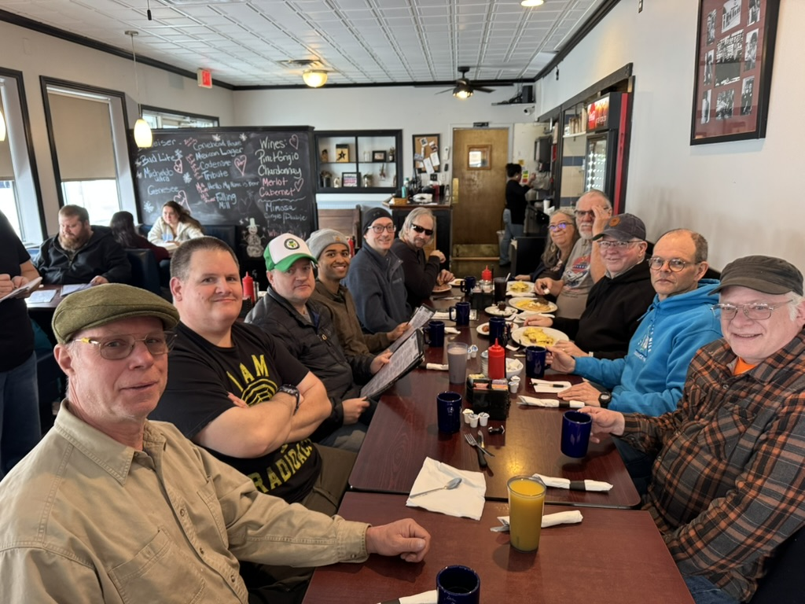
Old Business – Q1 Rag Chew @ Tim’s
L-R
N1GTC, Greg
NJ1S, Eric
N1FBZ, Mike
KC1ZGJ, Brandon
KE2ICI, Dylan
K2KI, Bob
KB1CNQ, Danielle
N1ARN, Arn
K9JY, Scot
N1KJ, Peter
KC1JAW, Rick
AC1RI, Matthias (took picture)

Slide 9
New Business
ARRL Open House – April 18th – 9:00 AM to 10:30 AM
Purpose is to invite people to see ham radio demonstrated
STARC will use this opportunity for members to come and see an operating station.
NJ1S providing the transceiver, K9JY providing the antenna
This will be at the St. Albans VFW
Emails going out next Monday for it, along with the VE session information
May Operating Event – Parks On the Air (POTA)
May 16th (Saturday)
Recommend a location
Volunteers to bring a station

Slide 10
Program
DMR Fundamentals, by Matt, K1VVM
This is a DMR basics class to get an idea of the structure of DMR radio programming and how they interact with repeaters. I hope this clears up some confusion with DMR and the terms it uses.
The May program will be held by Alain, VA2WE | KD2WE, on how digital radio repeaters bridge to the internet, along with reviewing the new ADK Multiprotocol Reflector, which was implemented to help converge traffic between several communication modes, including D-Star, DMR, C4FM, and analog.

