Slide 1
STARC March Meeting
March 12, 2026

Slide 2
Agenda
Treasurer Report
DX Report
Contesting Report
Old Business
New Business
Program

Slide 3
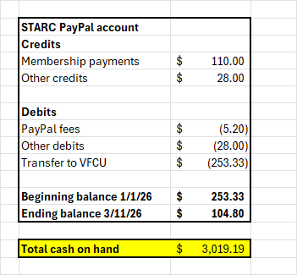
Treasurer Report

Slide 4
Treasurer Report (cont’d)
STARC
Financial report January 1 through March 11, 2026

Slide 5
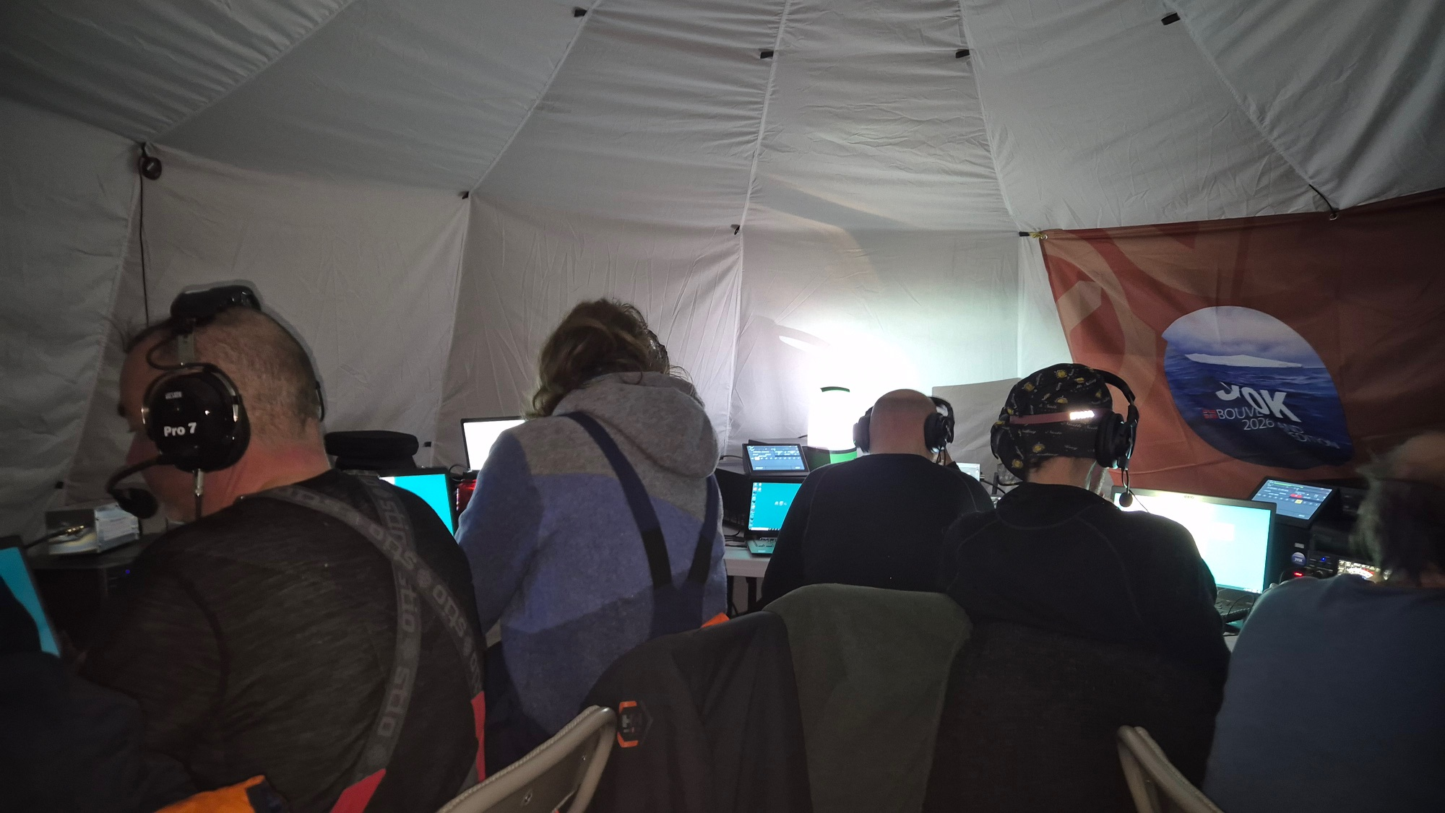
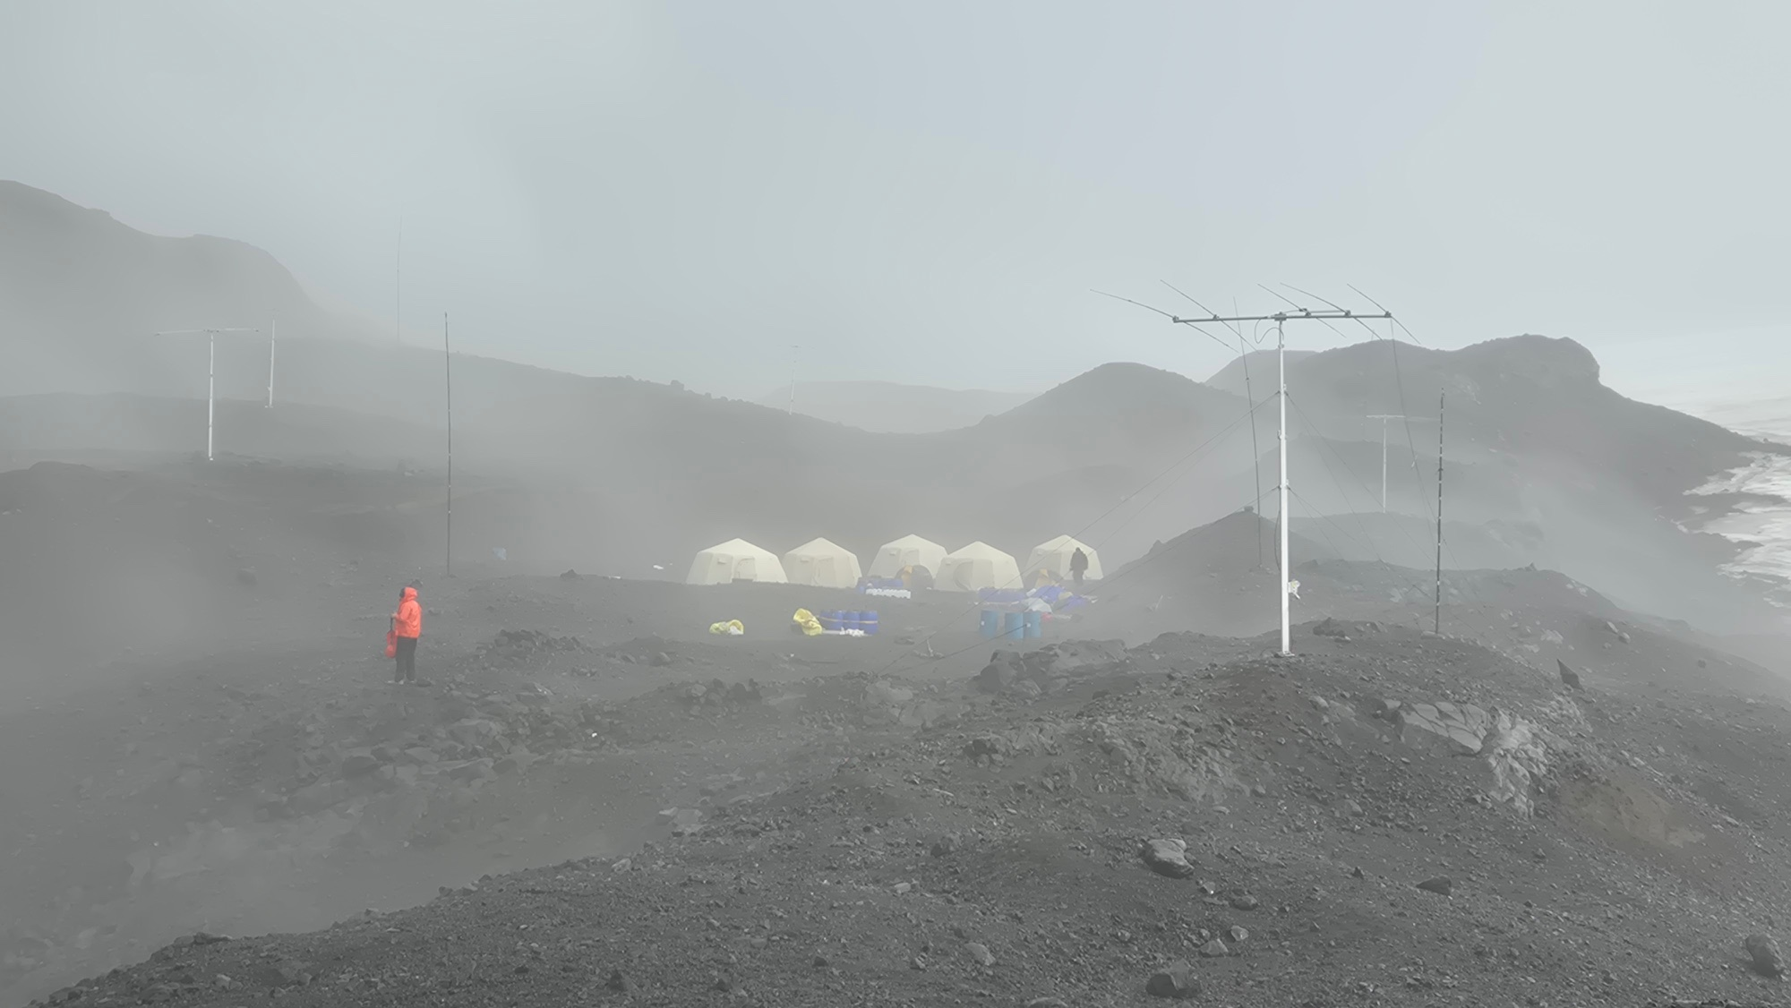
DX Report – Bouvet Island 3Y0K

Slide 6
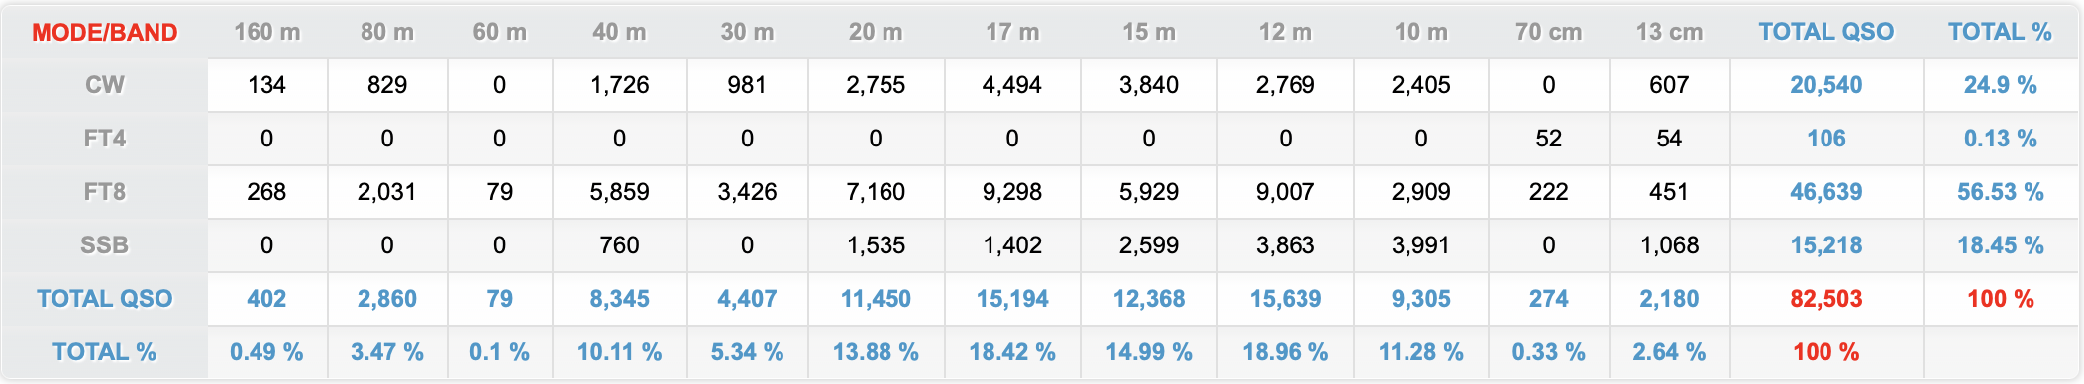
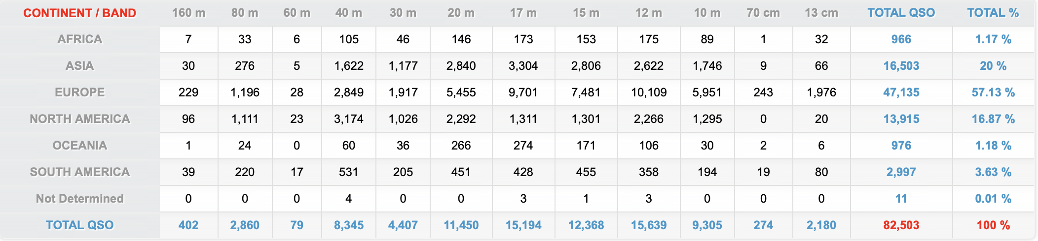
Bouvet Island statistics

Slide 7
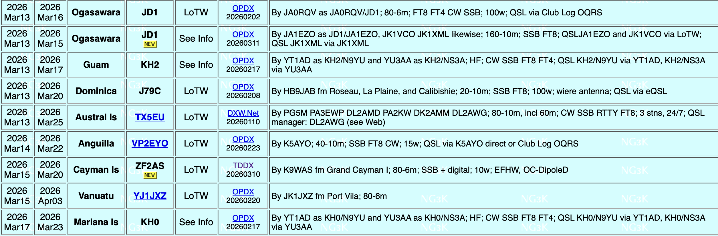
Upcoming DXpeditions
Courtesy of https://www.ng3k.com/Misc/adxo.html

Slide 8
SOTA Alerts
Friday, Mar 13, 1600 UTC KC1MXB, JB on Ludlow Mtn., VT 144.200 SSB & 144.100 CW
SOTA ref W1/GM-037, grid FN33oj 5 Watts Arrow 4 element Horizontal
Friday, Mar 13, 1600 UTC, K2CPT, Scott on Buck Mt, in the NY Catskills near Lake George
144.200 SSB & 144.100 CW, W2/GA-077, grid FN 33em
Sunday, Mar 15th at 1700 UTC, K1RID, Ed on Mount Shaw, Tuftonboro, NH 144.200 SSB & 144.100
CW SOTA ref W1/NL-001 grid FN43ir 5 watts to 2 element horizontal beam

Slide 9
Contest Report
ARRL DX SSB contest this past weekend
CQ WW WPX Contest, SSB 0000Z March 28th

Slide 10
Old Business – STARC 2026 Plan
Member Interest Survey Ranked
Proposed Programs by Month
Proposed Operating Events by Month
Proposed quarterly in-person events

Slide 11
All 19 Interests — Ranked by Member Votes (18 responses)
All 19 Interests — Ranked by Member Votes (18 responses)
DXing
9
Field Day
7
Public Service
7
VE Examiner
7
Rag Chewing
6
Net Operator / Participation
6
FT8 / FT4
6
POTA (Parks on the Air)
6
Other Digital Modes
5
ARES (EmComm)
5
Other (QRP, CW, VHF/UHF)
5
Satellite Communications
4
Contesting
3
Grid Square Hunting
2
SOTA
2
County Hunting
1
Fox Hunting
1
Moon Bounce (EME)
1
Other Awards
1
HIGH priority (6+ votes)
MED priority (3–5 votes)
LOW priority (1–2 votes)

Slide 12
Proposed Programs
Month | Program | Comments
January | Winter Field Day Preparation
February | Station Grounding and Lightning Protection | Getting ready for Spring
March | Northeast FM Repeater Association | UHF Statewide Communications System
April | Building Wire Antennas | Different wire antennas and performance
May | Digital Voice: D-Star and DMR systems | Integrating different modes
June | Field Day Preparation | Field Day - June
July | DX Deep Dive | Getting started Dxing
August | POTA 101: Parks on the Air
September | Intro to FT8 & WSJTx | Walk through the WSJT-X software, explain the FT8 protocol protocol,
October | Running a Net: NCS Training & Traffic Handling
November | ARES & Emergency Communications | Updated for Vermont and what STARC can do to support
December | Volunteer Examiner Program | Program purpose, how to become an Examiner, Testing process

Slide 13
Proposed Operating Events
Month | Operating Event | Comments
January | Winter Field Day
February | HAM-CON | Colchester - multiple programs, people
March | None this month
April | Ham Radio Open House | ARRL Event - set up station at VFW
May | POTA: Parks on the Air | POTA Activation: Lake Carmi
June | Field Day | Field Day - June 27, 28
July | SOTA - Summits on the Air | Jay Peak
August | POTA: Parks on the Air | POTA Activation: Kill Kare State Park
September | W1AW/1 Operation | September 23-29
October | Satellite Live Demonstration Pass | Pick a site; demonstration
November | TBD
December | TBD

Slide 14
Quarterly in-person get togethers
March 21st – Tim’s in St. Albans 9:30 – 11:00 Breakfast
June 20th – Station visit and grilling at K9JY’s – 12:00 Noon to 3:00 PM
September 19th -- Tim’s in St. Albans 9:30 – 11:00 Breakfast
December 19th – Tim’s in St. Albans 9:30 – 11:00 Breakfast

Slide 15
New Business
First Quarter get-together on March 21, 9:30 – 11:00 AM at Tim’s in St. Albans
This is the same weekend as the VE Exams, which start at 9:00 AM
Prefer to have you RSVP so that we can tell them how many people as it is busy on Saturday.
RSVP to Scot, K9JY at scot@k9jy.com

Slide 16
Program – Northeast FM Repeater Assoc.
Describing the linked UHF radio system that provides state-wide radio coverage.
By Mike, N1FBZ

